Slide 1
Chapter 4.5 : File Input/Output
Streams and Files
Text File I/O
Binary File I/O
Object Serialization

Slide 2
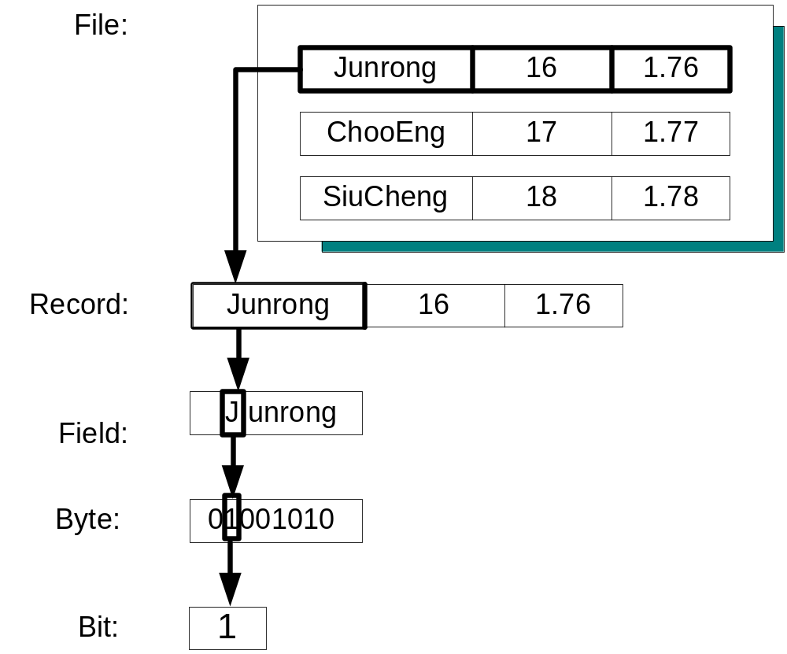
Files
Record 1
Record 2
Record 3
Data in Files
  Bits
  Byte
  Fields
  Records
  Files
File organization
  sequential files
  random files
Field1 Field2 Field3

Slide 3
Binary VS Text Files
Disk file streams work in a similar way as the standard input/output streams.
A file stream can be viewed as a continuous sequence of bytes.
Two modes of disk access: text mode and binary mode.
Text mode:
  Used for text files, data are stored and accessed
  as a sequence of characters
  Character-based files, e.g., .txt, .java, etc.
Binary mode:
  Used for binary files, data are stored and accessed
  as a sequence of bytes
  Byte-based files: data are stored in binary digits
  of 0 and 1, e.g., .exe, .ppt, .class, etc.

Slide 4
Chapter 4.5: File Input/Output
Streams and Files
Text File I/O
Binary File I/O
Object Serialization

Slide 5
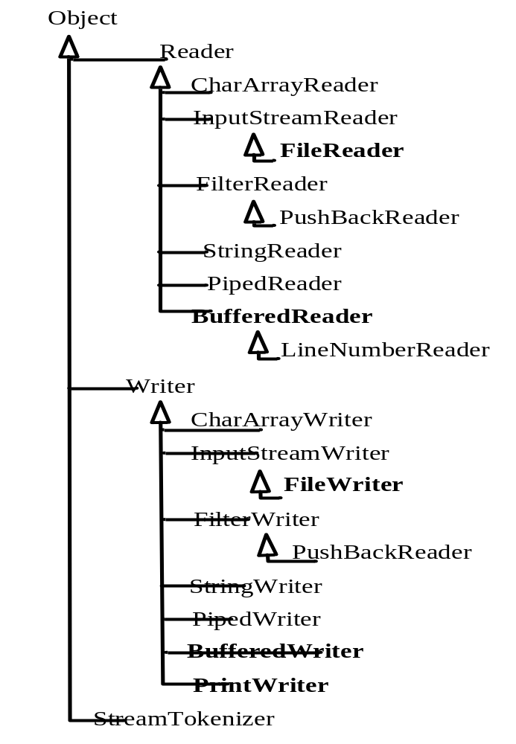
Text File I/O
Stream class hierarchy
http://java.sun.com/j2se/1.5.0/docs/api/java/io/Reader.html
http://java.sun.com/j2se/1.5.0/docs/api/java/io/Writer.html

Slide 6
Output Stream Classes for Writing Text Files
Class | Description | Methods
FileWriter | Provides the basic stream for text output. | write(), flush(), close()
BufferedWriter | Provides output buffering to improve performance. | write(), flush(), close()
PrintWriter | Provides a number of useful output methods for processing. | print(char), print(String), print(int), print(float), print(double), print(boolean), and the corresponding println() methods, flush(), close()
See http://java.sun.com/j2se/1.5.0/docs/api/java/io/FileWriter.html
In java IO package

Slide 7
Writing Text Files using a Buffered Stream Object
import java.io.*;
public class WritingTextFiles {
public static void main( String[] args ) {
try {
FileWriter fwStream = new FileWriter( "data.txt" );
BufferedWriter bwStream = new BufferedWriter( fwStream );
PrintWriter pwStream = new PrintWriter( bwStream );
int num ;
for ( num = 0 ; num < 5 ; num++ )
pwStream.println( "Number = " + num * 5 );
pwStream.close();
}
catch ( IOException e ) {
System.out.println( "IO Error!" + e.getMessage() );
e.printStackTrace();
System.exit( 0 );
}
}
}
Closing a file

Slide 8
Input Stream Classes for Reading Text Files
Class | Description | Methods
FileReader | Provides the basic stream for character-by-character input. | read(), close()
BufferedReader | Provides input buffering to improve performance. Provides both character-by-character and line-by-line input. | read(), readLine(), close()
See http://java.sun.com/j2se/1.5.0/docs/api/java/io/FileReader.html
In java IO package

Slide 9
Reading Text Files using the class BufferedReader
import java.io.* ;
public class ReadingTextFiles {
public static void main( String[] args ) {
try {
FileReader frStream = new FileReader( "data.txt" );
BufferedReader brStream = new BufferedReader( frStream );
String inputLine ;
int i ;
System.out.println( "The file contains:" );
for ( i = 0 ; i < 5 ; i++ ) {
inputLine = brStream.readLine(); // read in a line
System.out.println( inputLine );
}
brStream.close();
}
catch ( FileNotFoundException e ) {
System.out.println( "Error opening the input file!"
+ e.getMessage() );
System.exit( 0 );
}

Slide 10
Reading Text Files using the class BufferedReader
catch ( IOException e ) {
System.out.println( "IO Error!" + e.getMessage() );
e.printStackTrace();
System.exit( 0 );
}
}
}
Program Input and Output
The file contains:
Number = 0
Number = 5
Number = 10
Number = 15
Number = 20

Slide 11
Example: Using readLine
import java.util.Scanner ;
import java.io.* ;
public class FileCopying2 {
public static void main( String[] args ) throws IOException {
int ch ;
Scanner sc = new Scanner( System.in );
System.out.println( "Enter the input file name:" );
String fileName1 = sc.nextLine();
System.out.println( "Enter the output file name:" );
String fileName2 = sc.nextLine();
BufferedReader brStream =
new BufferedReader( new FileReader( fileName1 ) );
PrintWriter pwStream =
new PrintWriter( new BufferedWriter(
new FileWriter( fileName2 ) ) );
System.out.println( "The file contains:" );
String aString = brStream.readLine();
while ( aString != null ) {
System.out.println( aString );
pwStream.println( aString );
aString = brStream.readLine();
}
brStream.close();
pwStream.close();
} }
FileWriter fwStream = new FileWriter( fileName2);
BufferedWriter bwStream = new BufferedWriter( fwStream );
PrintWriter pwStream = new PrintWriter( bwStream );

Slide 12
Using Scanner Class
try
{
Scanner scStream = new Scanner( new File( "data.txt" ) );
String inputLine
System.out.println( "The file contains:" );
while ( scStream.hasNext() )
{
inputLine = scStream.nextLine();
System.out.println( inputLine );
}
scStream.close();
}
catch ( FileNotFoundException e )
{
System.out.println( "File Error!" + e.getMessage() );
System.exit( 0 );
}
catch ( IOException e )
{
System.out.println( "IO Error!" + e.getMessage() );
e.printStackTrace();
System.exit( 0 );
}

Slide 13
Chapter 4.5: File Input/Output
Streams and Files
File Stream Processing
Text File I/O
Binary File I/O
Object Serialization

Slide 14
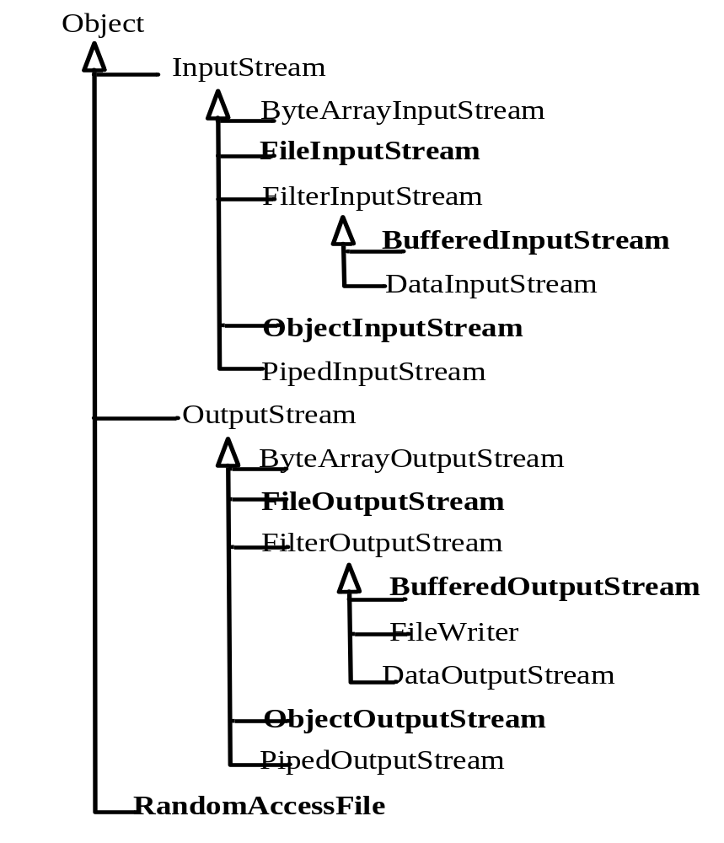
Binary File I/O
Stream class hierarchy

Slide 15
Output Stream Classes for Writing Binary Files
Class | Description | Methods
FileOutputStream | Provides the basic stream for text output. | write(), flush(), close()
BufferedOutputStream | Provides output buffering to improve performance. | write(), flush(), close()
ObjectOutputStream | Provides a number of useful output methods for processing. | writeByte(), writeBoolean(), writeBytes(), writeChar(), writeChars(), writeDouble(), writeFloat(), writeInt(), writeLong(), writeShort(), writeUTF(), flush(), close()
http://java.sun.com/j2se/1.5.0/docs/api/java/io/package-tree.html

Slide 16
Using the Class ObjectOutputStream to Write Binary Data
import java.io.* ;
import java.util.Scanner ;
public class WritingBinaryData {
public static void main( String[] args ) {
String fileName = " " ;
try {
String name ;
int age ;
double height ;
System.out.println( "Enter the file name: " );
Scanner sc = new Scanner( System.in );
fileName = sc.nextLine();
FileOutputStream foStream
= new FileOutputStream( fileName );
BufferedOutputStream boStream
= new BufferedOutputStream( foStream );
ObjectOutputStream doStream
= new ObjectOutputStream( boStream );
int i ;

Slide 17
for ( i = 0 ; i < 3 ; i++ ) {
System.out.print( "Enter name: " );
name = sc.next();
System.out.print( "Enter age: " );
age = sc.nextInt();
System.out.print( "Enter height: " );
height = sc.nextDouble();
doStream.writeUTF( name ); // name
doStream.writeInt( age ); // age
doStream.writeDouble( height ); // height
}
System.out.println( "Writing completed!" );
doStream.close();
}
catch ( FileNotFoundException e ) {
System.out.println( "IOError: File not found!" + fileName );
System.exit( 0 );
}
catch ( IOException e ) {
System.out.println( "File IO Error!" + e.getMessage() );
System.exit( 0 );
}
}
}

Slide 18
ObjectOutputStream Methods
Method | Description
writeByte(int b) | Writes the byte b to the data output stream.
writeBoolean(boolean b) | Writes the boolean b to the data output stream.
writeBytes(String s) | Writes the String s to the data output stream as a sequence of bytes.
writeChar(int c) | Writes the char c to the data output stream as a 2-byte Unicode value.
writeChars(String s) | Writes the String s to the data output stream as a sequence of characters. Each character is written as 2-byte Unicode value.
writeDouble(double d) | Writes the double d to the data output stream using 8 bytes.
writeFloat(float f) | Writes the float f to the data output stream using 4 bytes.
writeInt(int i) | Writes the int i to the data output stream using 4 bytes.
writeLong(long l) | Writes the long l to the data output stream using 8 bytes.
writeShort(short s) | Writes the short s to the data output stream using 2 bytes.
writeUTF(String s) | Writes the String s to the data output stream. UTF is a particular encoding method for the string.
flush() | Flushes the stream. This will write any buffered output bytes and flush through to the underlying stream.
close() | Closes the file output stream connection.
http://java.sun.com/j2se/1.5.0/docs/api/java/io/ObjectOutputStream.html
Further study: hardware level flush/sync, see java.io.FileDescriptor

Slide 19
Input Stream Classes for Reading Binary Files
Class | Description | Methods
FileInputStream | Provides the basic stream for byte-based input. | read(), close()
BufferedInputStream | Provides input buffering to improve performance. | read(), close()
ObjectInputStream | Provides a number of useful input methods for processing. | readByte(), readBoolean(), readChar(), readDouble(), readFloat(), readInt(), readLong(), readShort(), readUTF(), close()

Slide 20
Using the Class ObjectInputStream to Read Binary Data
import java.util.Scanner ;
import java.io.* ;
public class ReadingBinaryData1 {
public static void main( String[] args ) {
String fileName = " " ;
try {
String name ;
int age ;
double height ;
Scanner sc = new Scanner( System.in );
System.out.println( "Enter the file name: " );
fileName = sc.nextLine();
FileInputStream fiStream
= new FileInputStream( fileName );
BufferedInputStream biStream
= new BufferedInputStream( fiStream );
ObjectInputStream diStream
= new ObjectInputStream( biStream );
int i ;

Slide 21
Using the Class ObjectInputStream to Read Binary Data
for ( i = 0 ; i < 3 ; i++ )
{
System.out.print( "Name: " );
System.out.println( name = diStream.readUTF() );
System.out.print( "Age: " );
System.out.println( age = diStream.readInt() );
System.out.print( "Height: " );
System.out.println( height = diStream.readDouble() );
}
diStream.close();
}
catch ( FileNotFoundException e ) {
System.out.println( "IOError: File not found!" + fileName );
System.exit( 0 );
}
catch ( IOException e ) {
System.out.println( "File IO Error!" + e.getMessage() );
System.exit( 0 );
}
}
}

Slide 22
ObjectInputStream Class Methods
Method | Description
readByte() | Reads a byte from the data input stream.
readBoolean() | Reads a boolean from the data input stream.
readChar() | Reads a char (2 bytes) from the data input stream.
readDouble() | Reads a double (8 bytes) from the data input stream.
readFloat() | Reads a float (4 bytes) from the data input stream.
readInt() | Reads an int (4 bytes) from the data input stream.
readLong() | Reads a long (8 bytes) from the data input stream.
readShort() | Reads a short (2 bytes) from the data input stream.
readUTF() | Reads a String value from the data input stream.
close() | Closes the file input stream connection.

Slide 23
Reading Binary Data with End of File Testing
import java.io.* ;
import java.util.Scanner ;
public class ReadingBinaryData2 {
public static void main( String[] args ) {
String fileName = " " ;
try {
String name ;
int age ;
double height ;
Scanner sc = new Scanner( System.in );
System.out.println( "Enter the file name: " );
fileName = sc.nextLine();
FileInputStream fiStream
= new FileInputStream( fileName );
BufferedInputStream biStream
= new BufferedInputStream( fiStream );
ObjectInputStream diStream
= new ObjectInputStream( biStream );
int i ;

Slide 24
When reading beyond the file, an end-of-file
Exception (EOFException) is thrown
Use end-of-file exception for testing end-of-file
try {
while ( true ) {
System.out.print( "Name: " );
System.out.println( name = diStream.readUTF() );
System.out.print( "Age: " );
System.out.println( age = diStream.readInt() );
System.out.print( "Height: " );
System.out.println( height = diStream.readDouble() );
}
}
catch ( EOFException e ) {} // or IOException
diStream.close();
}
catch ( FileNotFoundException e ) {
System.out.println( "IOError: File not found!" + fileName );
System.exit( 0 );
}
catch ( IOException e ) {
System.out.println( "File IO Error!" + e.getMessage() );
System.exit( 0 );
}
}
}
1:
2:
3:
to catch the end-of-file
exception
Note more specific catch blocks first, then the general one

Slide 25
Chapter 4.5: File Input/Output
Streams and Files
File Stream Processing
Text File I/O
Binary File I/O
Object Serialization

Slide 26
Object Serialization
To read an entire object from or write an entire object to a file, Java provides object serialization.
  http://java.sun.com/developer/technicalArticles/Programming/serialization/
  Object serialization is the process of saving an object's state to a sequence of bytes, as well as the process of rebuilding those bytes into a live object at some future time.
  The Java Serialization API provides a standard mechanism for developers to handle object serialization.
A serialized object is represented as a sequence of bytes that includes the object’s data and its type information.
After a serialized object has been written into a file, it can be read from the file and deserialized to recreate the object in memory.

Slide 27
Classes ObjectInputStream and ObjectOutputStream, which respectively implement the ObjectInput and ObjectOutput interfaces, enable entire objects to be read from or written to a stream.
To use serialization with files, initialize ObjectInputStream and ObjectOutputStream objects with FileInputStream and FileOutputStream objects, respectively.
A demo application:
  ObjectInputOutputDemo.java // demo of saving some objects into a file using ObjectOutputStream and retrieving them bask using ObjectInputStream

Slide 28
ObjectOutput interface method writeObject takes an Object as an argument and writes its information to an OutputStream.
A class that implements ObjectOuput (such as ObjectOutputStream) declares this method and ensures that the object being output implements Serializable.
ObjectInput interface method readObject reads and returns a reference to an Object from an InputStream.
  After an object has been read, its reference can be cast to the object’s actual type.

Slide 29
Creating a Sequential-Access File Using Object Serialization
Objects of classes that implement interface Serializable can be serialized and deserialized with ObjectOutputStreams and ObjectInputStreams.
Interface Serializable is a tagging interface.
  It does not contain methods.
A class that implements Serializable is tagged as being a Serializable object.
An ObjectOutputStream will not output an object unless it is a Serializable object.

Slide 30
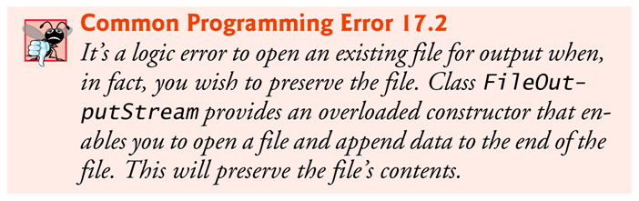
In a class that implements Serializable, every variable must be Serializable.
Any one that is not must be declared transient so it will be ignored during the serialization process.
All primitive-type variables are serializable.
For reference-type variables, check the class’s documentation (and possibly its superclasses) to ensure that the type is Serializable.
FileOutputStream(File file, boolean append)

Slide 31
ObjectInputStream method readObject reads an Object from a file.
Method readObject throws an EOFException if an attempt is made to read beyond the end of the file.
Method readObject throws a ClassNotFoundException if the class for the object being read cannot be located.

Slide 32

Thank you !!!

